Slide 1
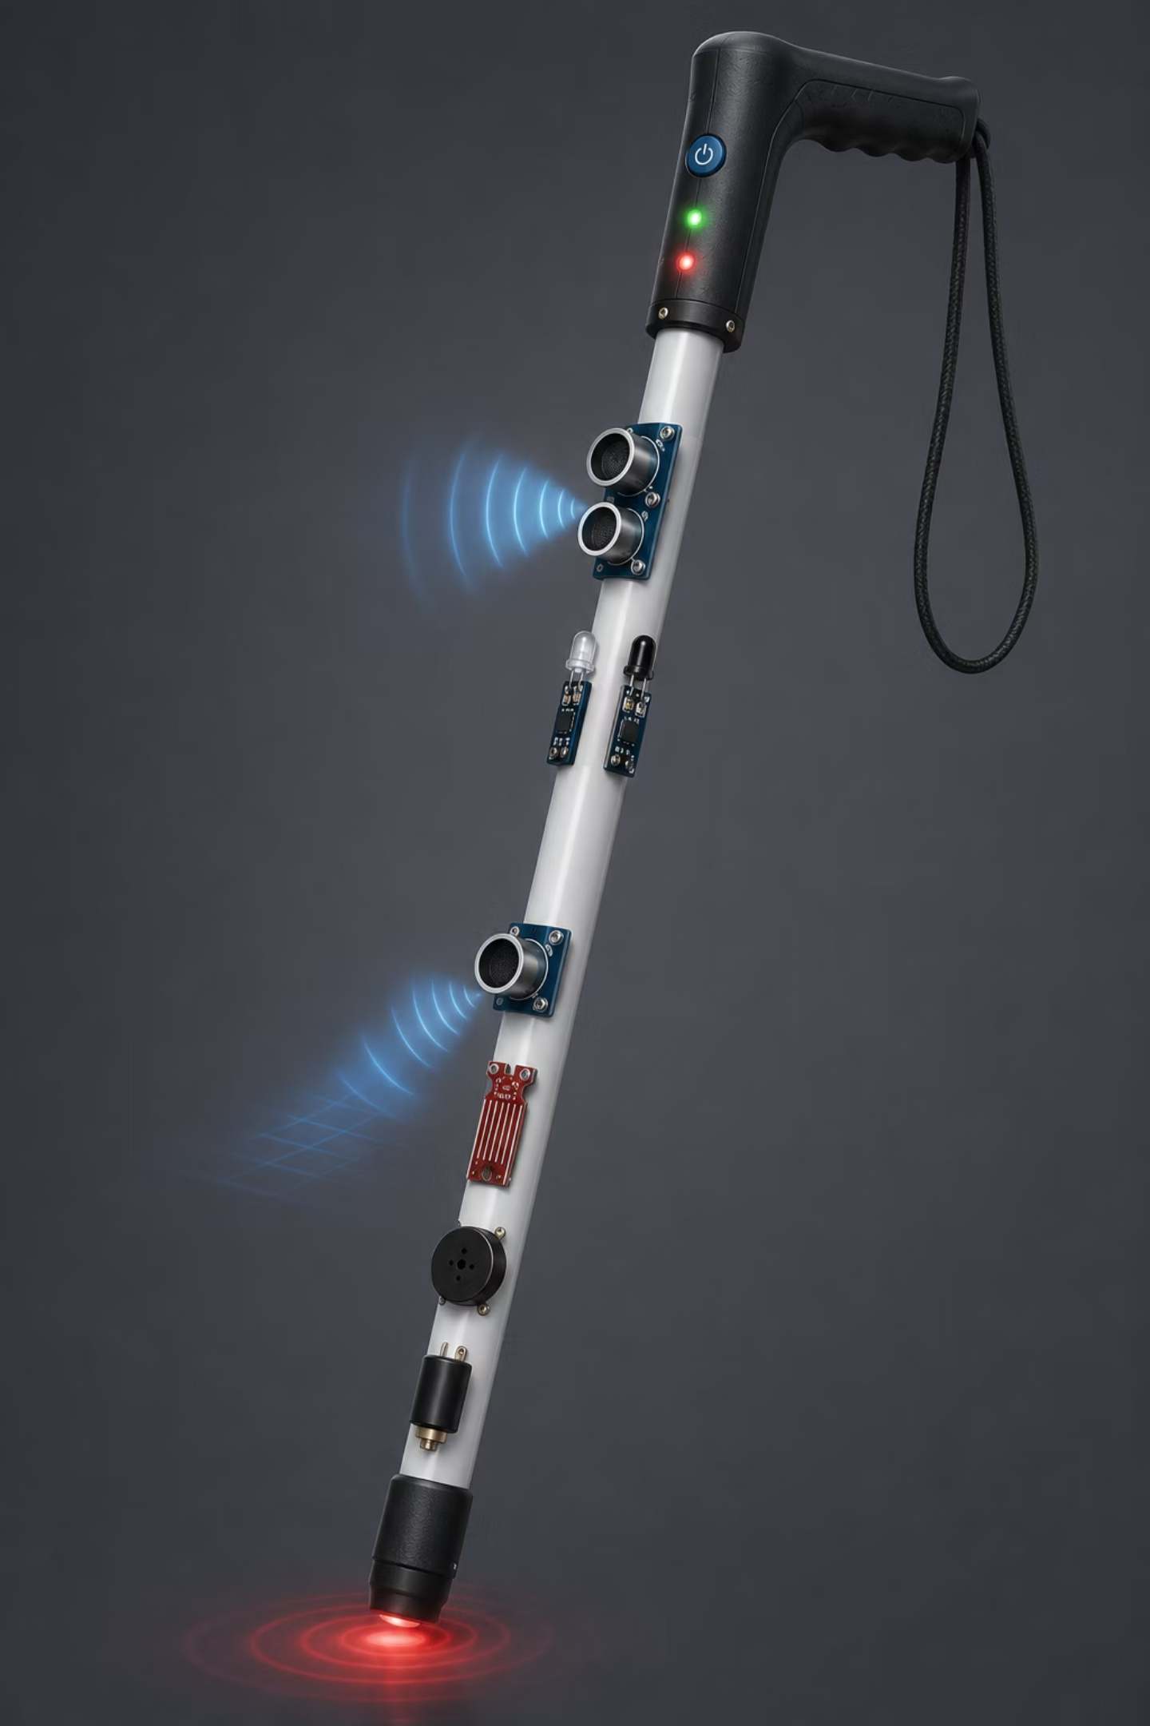
Smart Blind Stick with Hazard Detection and GPS Tracking
First Year Applied Electromechanics Engineering Project · Department of Computer Engineering
ASSISTIVE TECHNOLOGY
EMBEDDED SYSTEMS
ARDUINO PLATFORM

Slide 2

The Problem: Getting Around Without Seeing
People who cannot see well face daily dangers. It can make it harder to stay safe and independent.
Running Into Things
Walls, poles, and furniture can cause injuries without warning.
Water on the Ground
Puddles and wet floors can lead to slips and falls.
Holes & Stairs
Drop-offs and stairs are hard to notice with a regular cane.
No Way to Track Location
Families cannot find users quickly if they get lost or need help.

Slide 3
Project Objectives
Six simple goals guide this prototype.
1
2
Spot Obstacles Right Away
Notice Water on the Ground
Little sensors find objects 2–400 cm away.
A sensor spots puddles before the cane touches them.
3
4
Find Holes and Stairs
Give Two Kinds of Alerts
A sensor pointing down spots sudden drop-offs.
A buzzer and a vibrating motor give sound and touch alerts.
5
6
Share Location
Make Users Safer and More Independent
The GPS module sends live location data.
Help users rely less on caregivers and feel more confident.

Slide 4
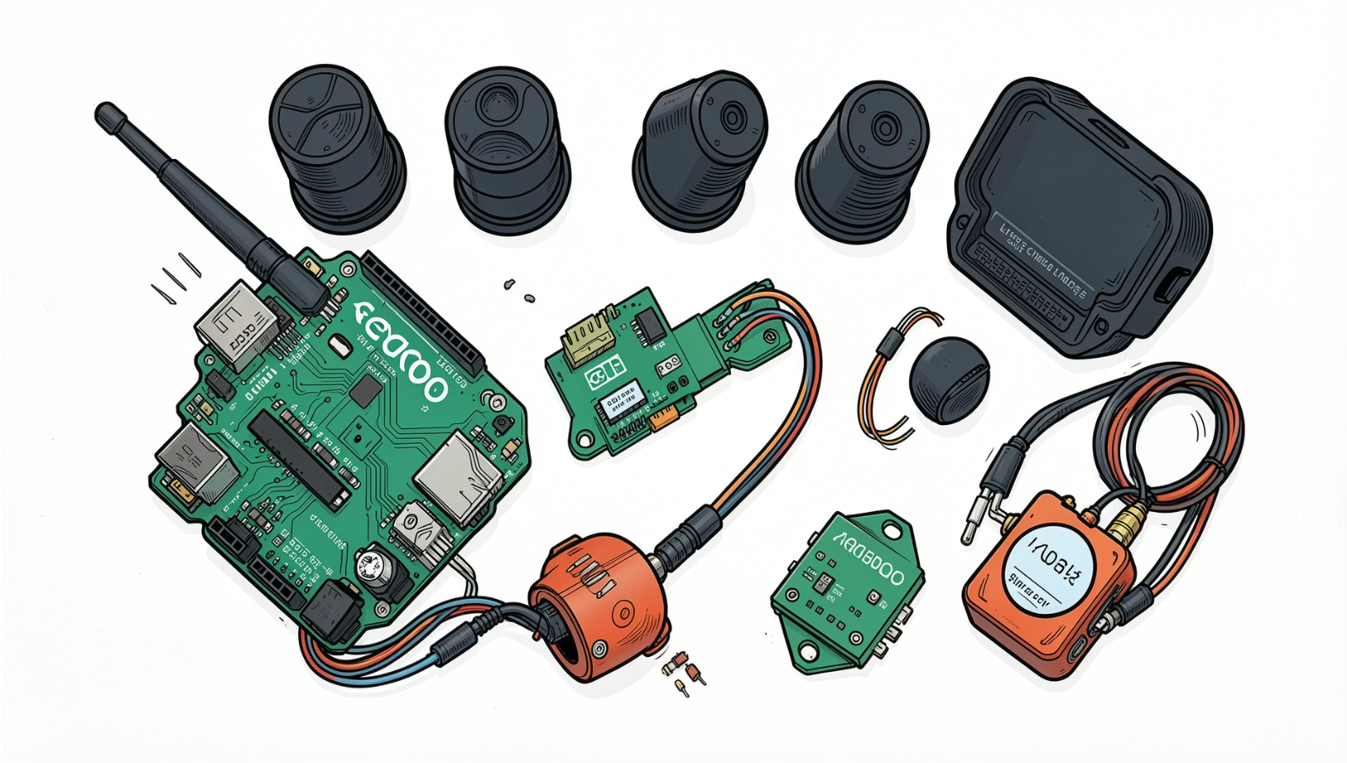
Components Used
Component
Function
Arduino Uno
Main controller
HC-SR04 ×2
Finds obstacles and drops
IR Sensors ×2
Finds side obstacles
Water Sensor
Detects puddles
NEO-6M GPS
Tracks location
Piezo Buzzer
Makes sound alerts
Vibration Motor
Gives haptic alerts
S8050 Transistor
Controls the motor
Push Button
Turns the system on and off
9V Battery
Powers the system

Slide 5
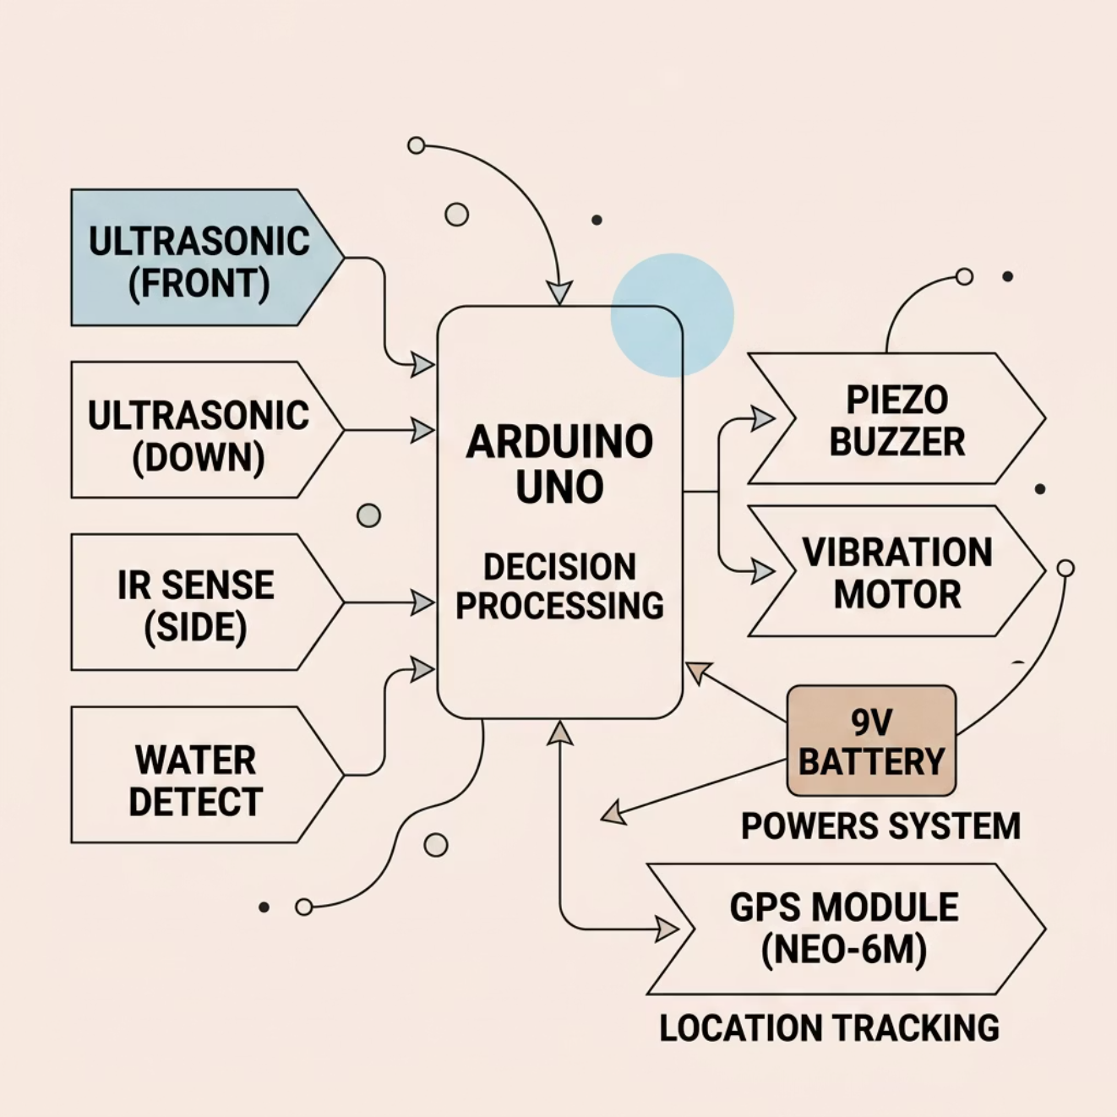

System Architecture
Three layers of sensors send data to the Arduino. It then turns on alerts and saves the GPS location.
Signal Flow
Sensors keep checking around
Arduino looks at the readings
Alerts switch on fast
GPS location updates by itself
9V battery powers everything

Slide 6

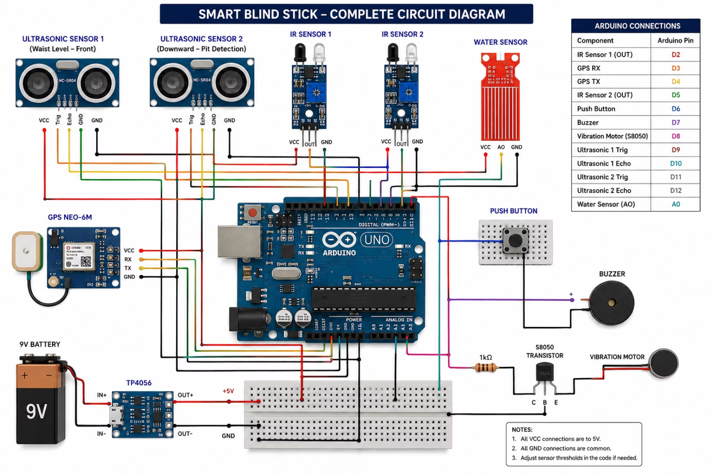
Circuit Diagram
Full wiring for the Smart Blind Stick prototype.
Key Connections
Sensor power → Arduino 5V line
Trigger/Echo pins → Digital pins
Buzzer → output pin
Motor → S8050 driver part
GPS TX → Arduino RX

Slide 7

Working Methodology
The firmware keeps running all the time. It checks the sensors and sends alerts fast when it spots danger.
Generate Alert
Sensor Poll
Hazard Detect
Arduino Logic
GPS Log
All checks run in a non-blocking loop. That means the system stays responsive even while GPS updates are still loading.

Slide 8
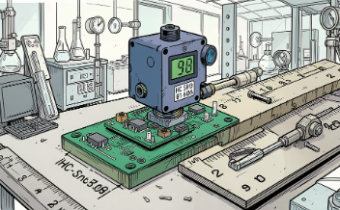
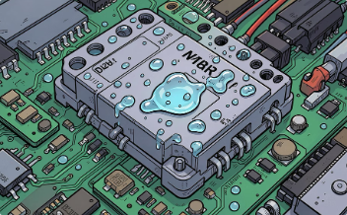
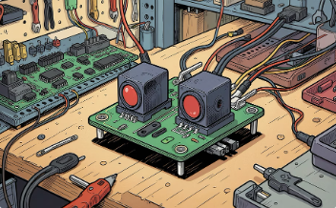
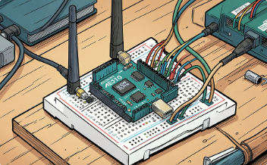
Implementation & Testing
We checked each part on its own first. Then we connected everything.
Ultrasonic Sensors
Water Detection
IR Side Sensors
GPS Tracking
The front sensor finds things in the way. The lower sensor spots holes.
The sensor warns before the device touches water.
These sensors notice things nearby on the sides.
The GPS sends location details through a serial link.

Slide 9

Results, Advantages & Limitations
✅ Verified Results
⚠️ Current Limitations
Obstacle detection: works from 2–400 cm
Water detection: alerts right away when it touches water
Pit detection: the lower sensor works
GPS coordinates: saved in the serial monitor
Dual alerts: buzzer and vibration both work
GPS accuracy depends on signal quality
The 9V battery limits how long it can run
No voice help or phone alerts yet
All the main checking and alert features worked well. These limits will be improved later.
✅ Key Advantages
Cheap, easy to carry, and simple to use
Finds more than one danger at the same time

Slide 10
Conclusion & Future Scope
The Smart Blind Stick shows that simple, low-cost tools can help keep people with vision loss safer in real time.
GSM SOS Alerts
Voice Navigation
Emergency messages to caregivers
Spoken hazard alerts
Mobile App
ESP32 Upgrade
Live location tracking and alerts
Better wireless support
AI Camera
Cloud Tracking
Object detection with smart processing
Remote monitoring dashboard
Thank You

